Slide 1

ENDORISK
Preoperative risk stratification using Bayesian networks and data

Slide 2
Structure
Background
01
Cohorts
03
Results
04
Cohorts
Network changes
Conclusion
05
Future research
06
Cross-validation
Endometrial carcinoma
ENDORISK
Original cohort
Brno
Tübingen
Additions
02
TCGA molecular groups
Imaging myometrial invasion

Slide 3
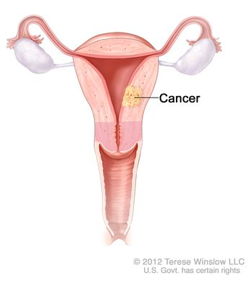
Endometrial carcinoma
7th most common cancer in women worldwide
Risk factors:
Excess oestrogen
Age
Overweight
Treatment methods:
Hysterectomy
Possible adjuvant therapy
Possible lymphadenectomy
(Sung et al. 2021;
Lu et al. 20220)

Slide 4
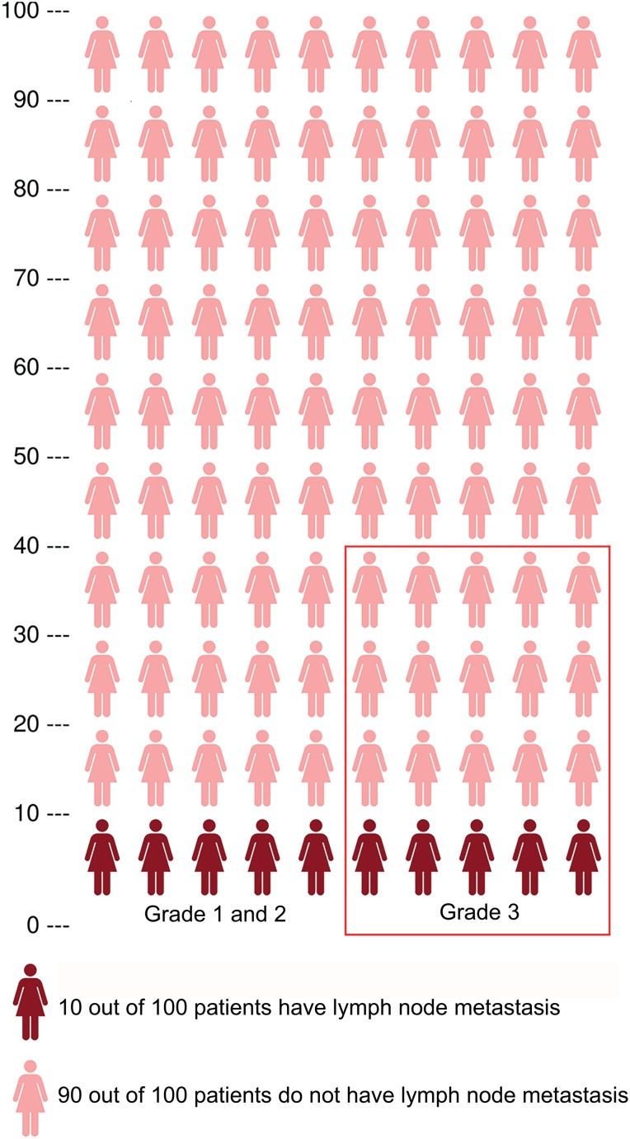
Lymphadenectomy
Routine in grade 3 (high-risk) tumours
Imperfect solution
Unnecessary removals
Missed metastases
Complications
Extended recovery time
Lymphoedema
Deep vein thrombosis
(Reijnen et al. 2019)

Slide 5
ENDORISK network
Bayesian network
Multimodal pre- and postoperative markers
Presents chance of:
Lymph node metastasis
Survival
Validated by 4 cohorts
Improvement points:
Key variables to be added
Optimistic about five-year survival
Underestimates clinically advanced tumours

Slide 6
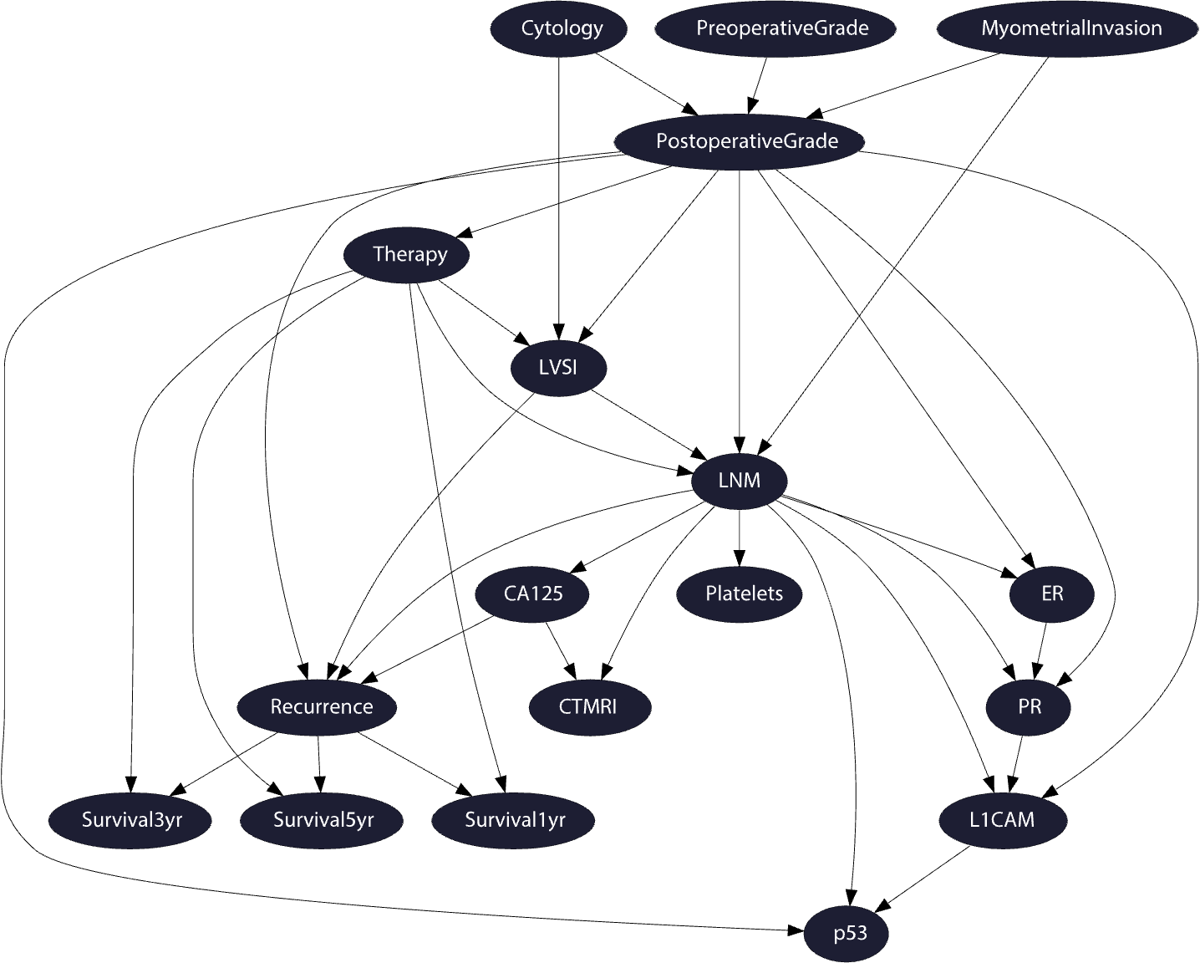

Slide 7
Proposed additions

Slide 8
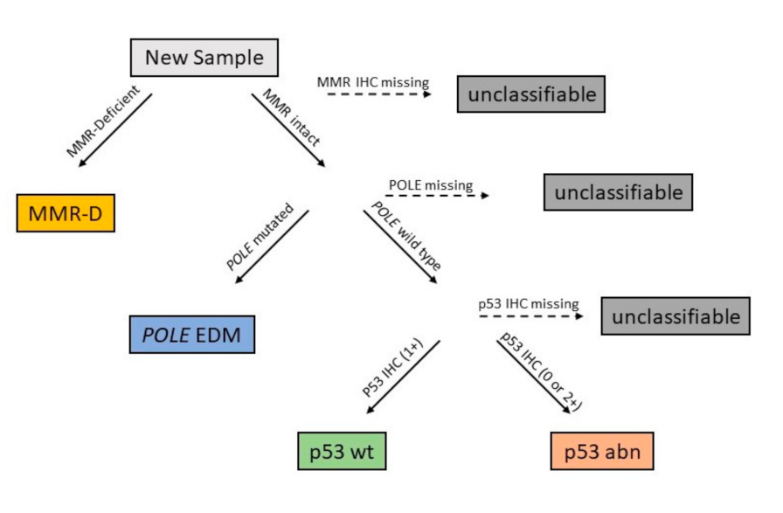
Additions – TCGA molecular variables
(Alexa et al. 2021)

Slide 9
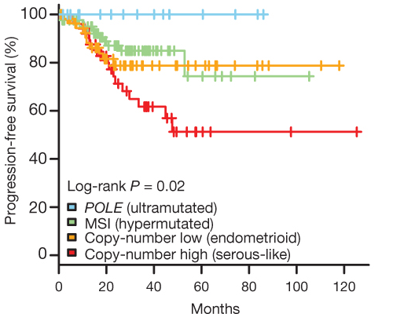
Additions – TCGA molecular variables
(Levine et al. 2013)

Slide 10
Additions – imaging myometrium invasion
MRI
US
Sensitivity 80% [73 – 86]
Specificity 81% [70 – 89]
Utilised to detect enlarged lymph nodes
Expensive
Sensitivity 78% [68 – 87]
Specificity 82% [75 – 88]
Cheap and available in more clinical settings
Expert needed
(Spagnol et al. 2022)
(Ziogas et al. 2022)
Combine into an imaging MI node

Slide 11
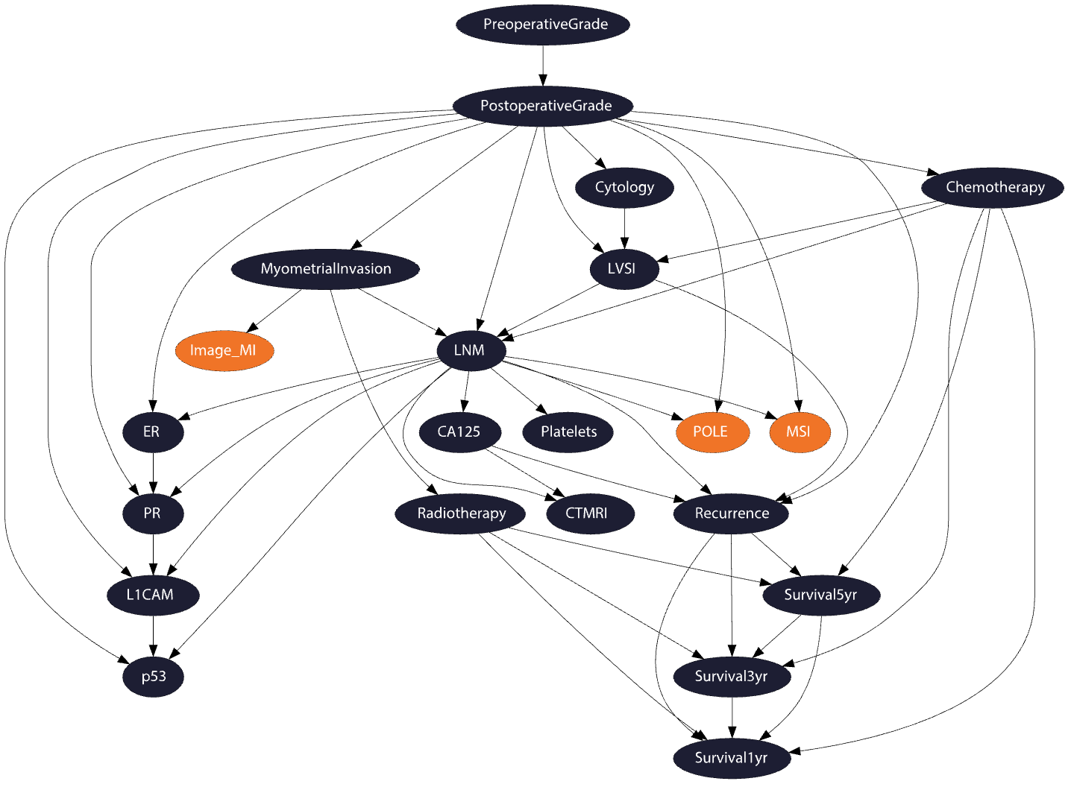

Slide 12
Cohorts
763 patients
Spread through Europe
IHC and grade information
Original
Extended to 952 patients
+MRI MI
+TCGA
Extended original
581 patients
+ Ultrasound MI
+ TCGA
Extension
Brno
247 patients
- Imaging MI
+TCGA
Tübingen

Slide 13
Imaging diagnosis of MI – Presents unexpected correlation
Training - MRI
Brno - US

Slide 14
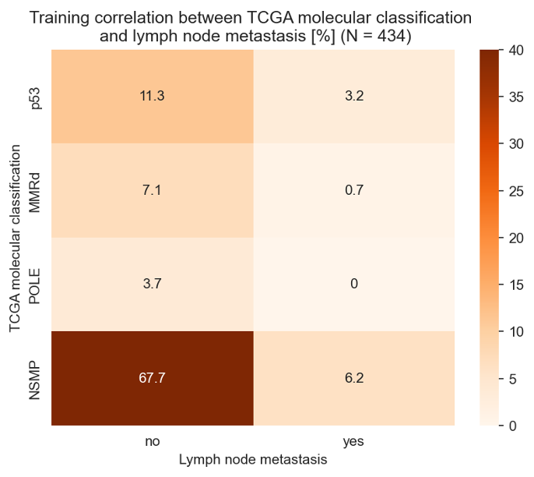
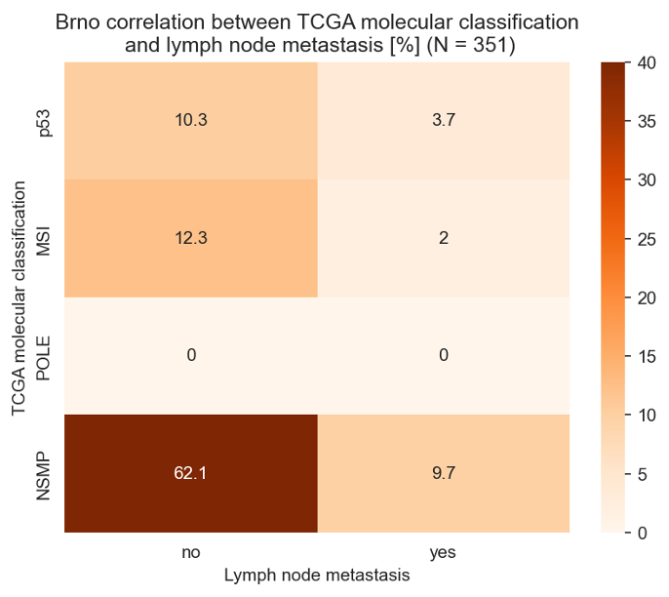
TCGA groups correlation LNM – conforms to literature
Training
Brno

Slide 15
Results

Slide 16
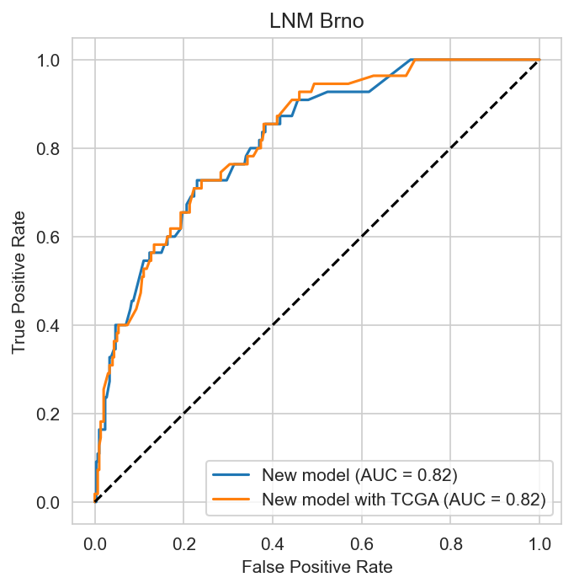
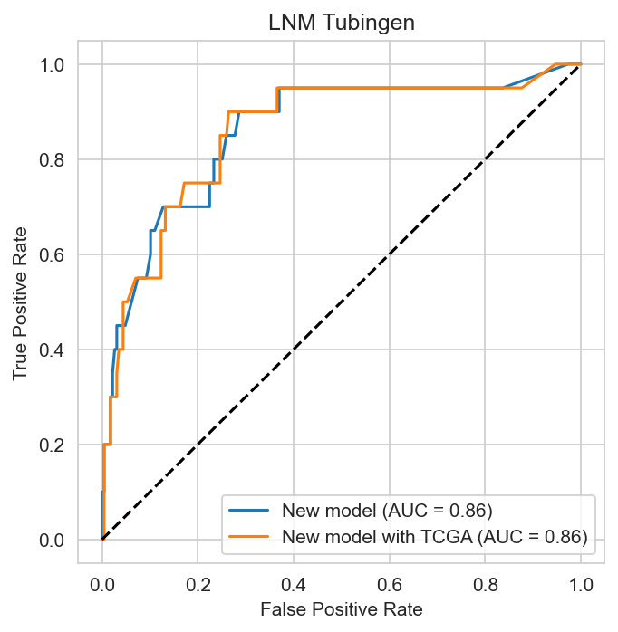
Addition TCGA – little effect with all evidence available
Brno
Tübingen

Slide 17
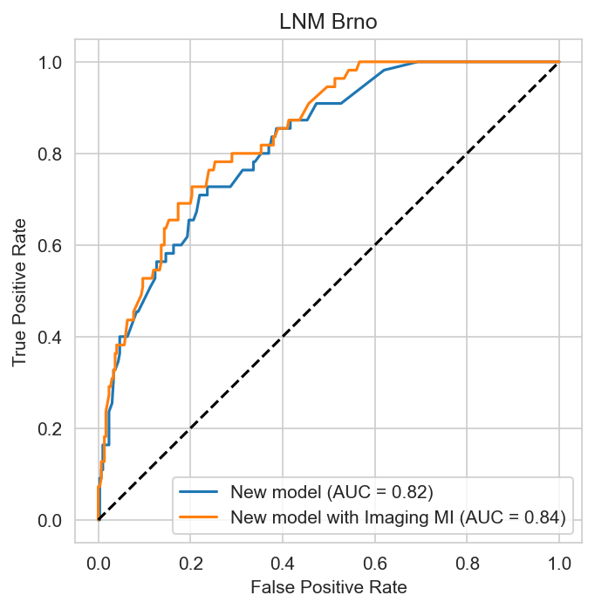
Addition imaging MI - slight effect, all evidence available

Slide 18

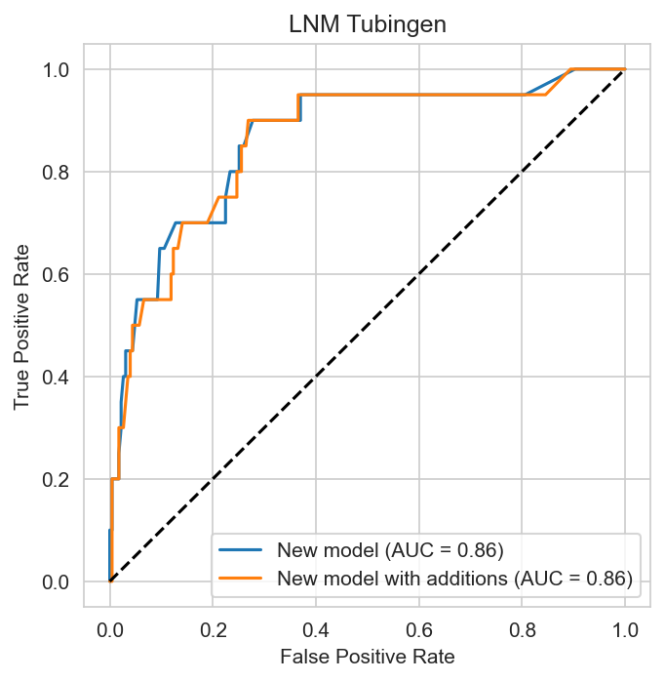
All additions – Results reflect separate additions
Brno
Tübingen

Slide 19
Minimal evidence sets

Slide 20
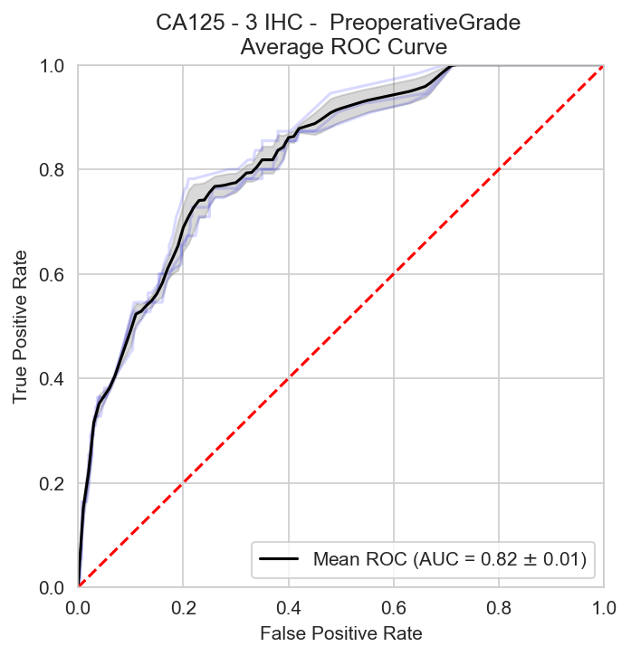
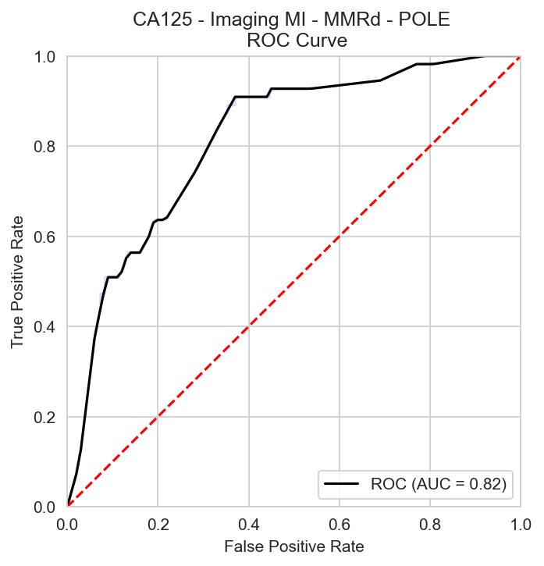
Minimal variables – New evidence sets created

Slide 21
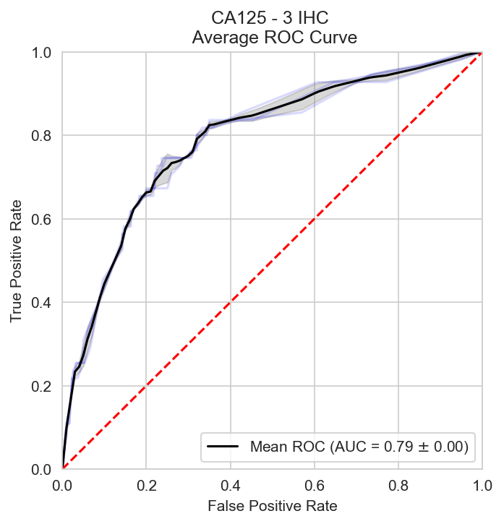
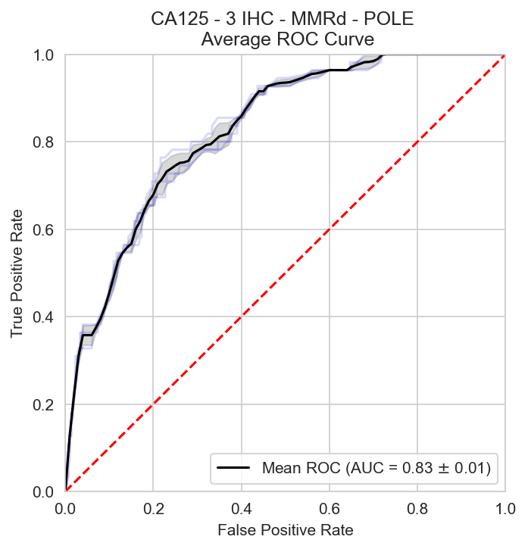
Minimal variables – Improvement without preoperative grade

Slide 22
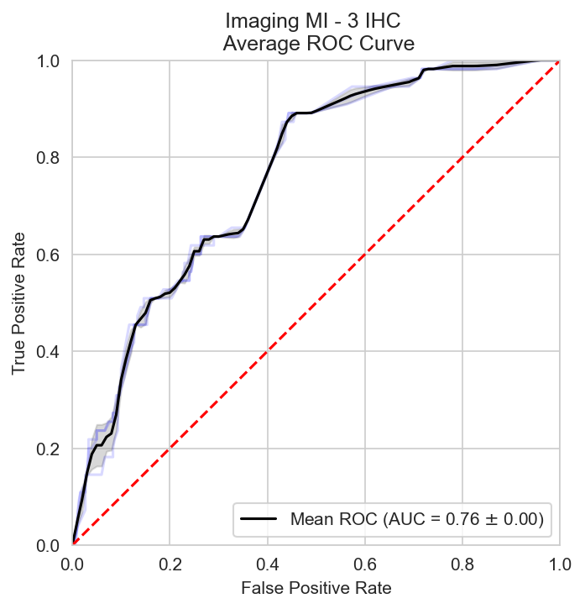
Minimal variables – Imaging MI demonstrates strong predictive strength next to CA125

Slide 23
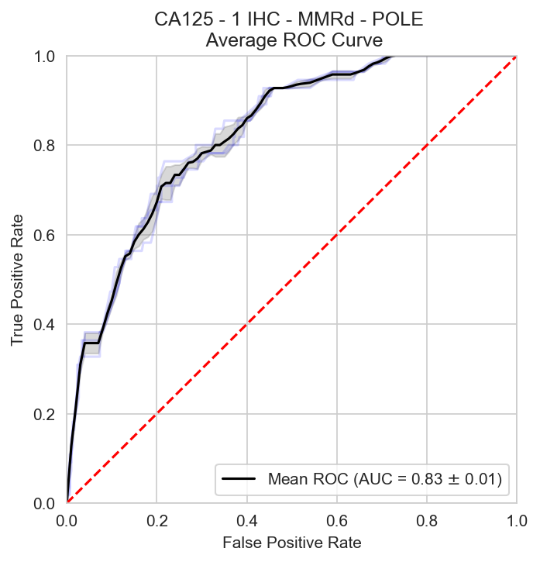
Minimal variables – Versatility of the model strongly increases

Slide 24
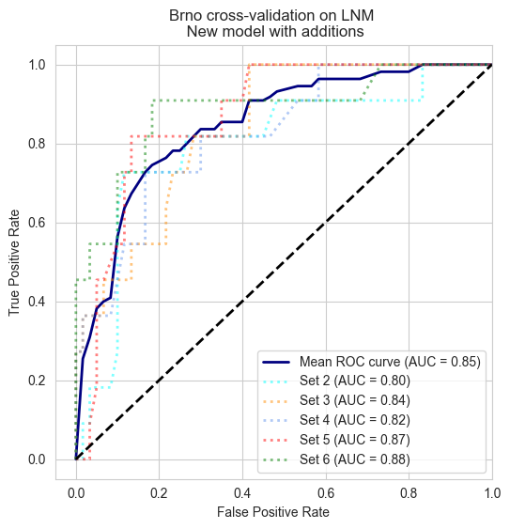
Brno dataset cross-validation and extension increases robustness

Slide 25
Conclusions
TCGA groups reinforce existing results and evidence
Imaging MI gives a slight improvement
Greatly increased versatility
Extension with Brno supports Imaging MI with US data

Slide 26
Future Research
Further exploration of (informed) imputation techniques
Analysis and improvement of the survival side of the model
Enhance the MRI MI data
Clinical trial (ENDORISK-I)

